Slide 1
Finance – Predictive Analytics
A Data Science Project by:
Lucky D. Camaddu

Slide 2







































































































Slide 3



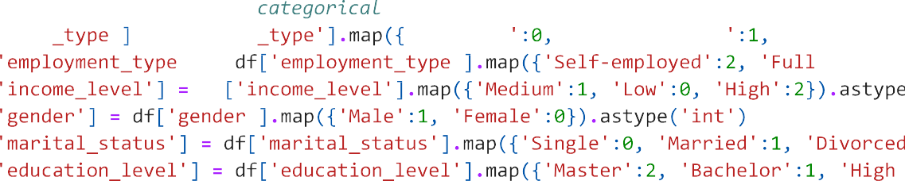



















































Slide 4




















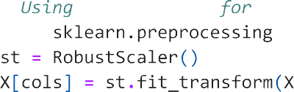
























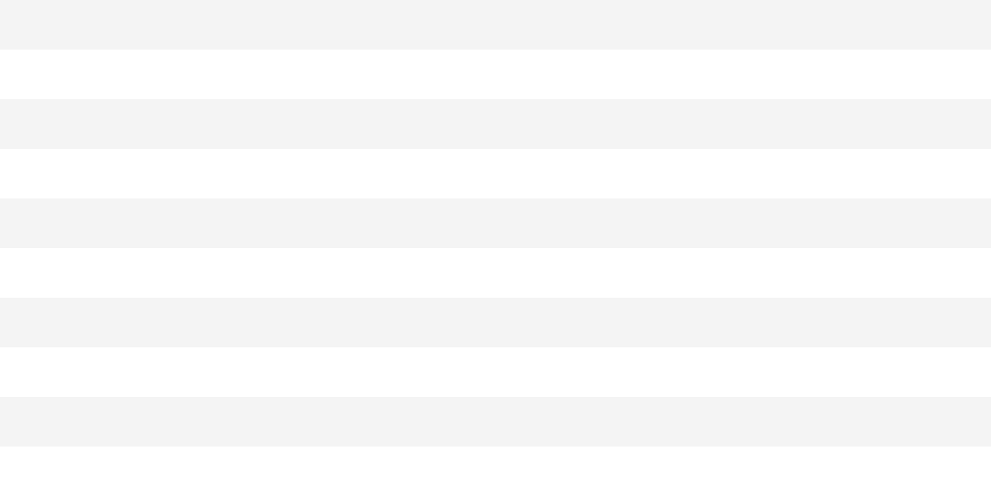



























































































Slide 5





























































Slide 6





